Slide 1
Acetaminophen & NSAID
Maryam Farasatinasab, Pharm D
Assistant Professor of Clinical Pharmacy
IUMS, Tehran, Iran

Slide 2
The Horses
Master Ali Asghar Tajvidi’s

Slide 3
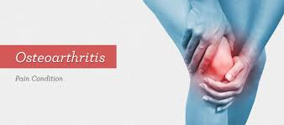
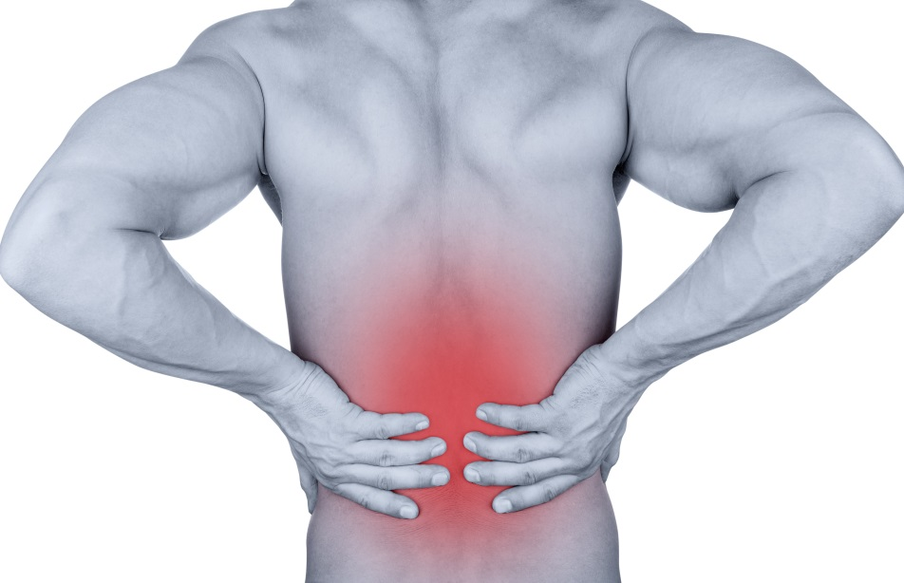
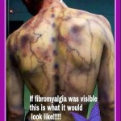
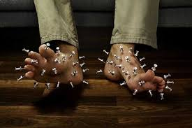
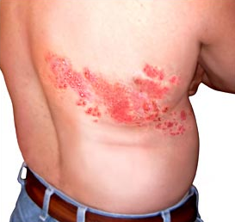

Slide 4
Introduction
Pain is defined as "an unpleasant sensory and emotional experience associated with actual or potential tissue damage or described in terms of such damage˝.
Pain is a hallmark of many chronic conditions, affecting more than 25% of Americans over the age of 20 years.
The most common types of pain include low back pain, headache, and joint pain.
Applied Therapeutics. 2018 International Association for the Study of Pain. 2011 National Center for Health Statistics. 2011

Slide 5
Introduction
Many people think that pain is a natural part of growing older, and up to 60% of people believe that pain is just something you have to live with
Chronic pain: women > men , non-Hispanic white people & in those whose income is two times less than the level of poverty.
Applied Therapeutics. 2018 International Association for the Study of Pain. 2011 National Center for Health Statistics. 2011 Pain in America: A Research Report. 2000

Slide 6
Introduction
Pain is more complex than just physiology.
A person's perception of pain is affected by environmental, emotional, cultural, spiritual, and cognitive factors.
Unrelieved chronic pain affects not only physical well-being but also a person's psychological and social well-being, as well as relationships with loved ones.
Applied Therapeutics. 2018 National Institutes of Health. NIH Guide: New Directions in Pain Research 2010 American Pain Society. 2010

Slide 7
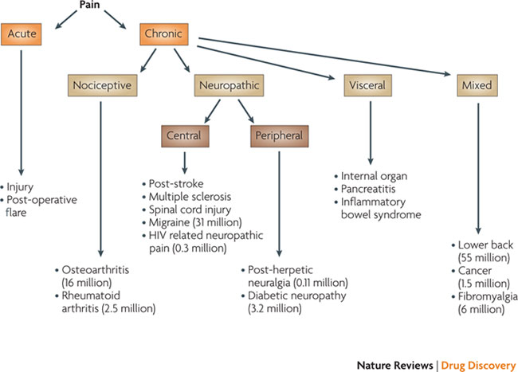
Pain Classification
Nature Reviews Drug Discovery , 2010; 9, 589-590
Centers for Disease Control and Prevention, National Center for Health Statistics, Arthritis Foundation, The American Pain Foundation.

Slide 8
Musculoskeletal Pain
Dysfunctional Pain
Best Pract Res Clin Rheumatol. 2011;25(2):141-154.

Slide 9
Rosewater Dream
Master Ali Asghar Tajvidi’s

Slide 10
Acetaminophen & NSAIDs

Slide 11
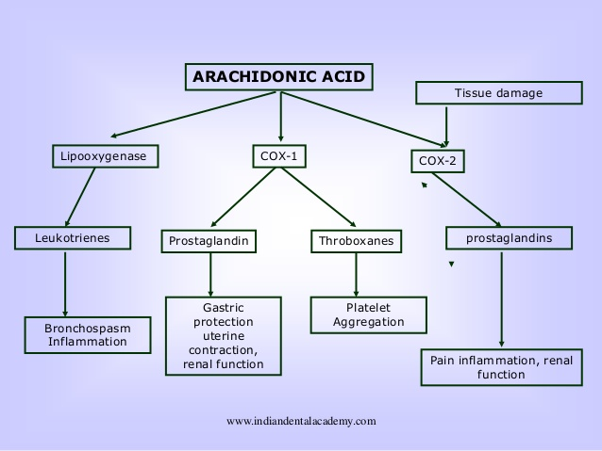
The Current COX Concept

Slide 12
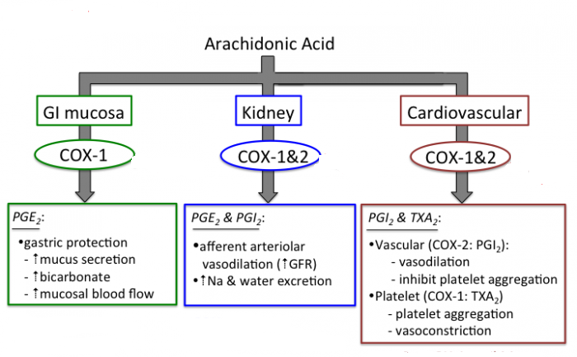
The Current COX Concept
COX-1 is a component of normal cells mediating production of prostaglandins involved in normal physiological functions such as cytoprotection of gastric mucosa and regulation of renal blood flow, and COX-2 is the inducible form of the enzyme expressed in inflammatory cells

Slide 13
Acetaminophen
Acetaminophen is an effective oral analgesic and antipyretic. It is equianalgesic and equipotent with ASA in most types of pain, excluding inflammatory arthritic pain.
Given its safety profile, acetaminophen can still be considered the first-line drug for patients with pain.
It is a weak inhibitor of prostaglandin synthesis in peripheral tissues, but has been postulated to exert analgesic effects by selective inhibition of prostaglandin formation in the brain. Growing evidence supports the involvement of a central serotonergic mechanism in analgesic actions of acetaminophen

Slide 14
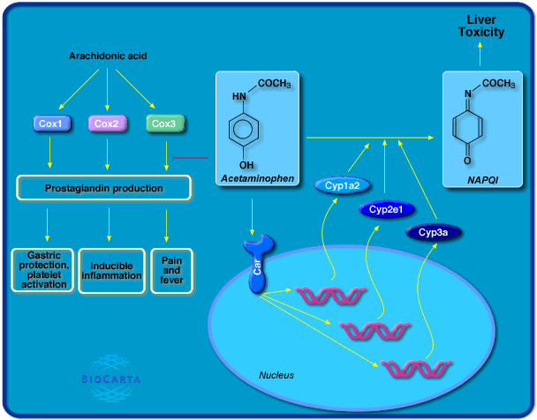
Acetaminophen

Slide 15
Acetaminophen
2- to 3-week trial in doses typically less than 4 g/day or less than 3 g/day in patients older than 65 years, unless clinically contraindicated.
In recommended doses, acetaminophen is well tolerated and side effects are mild. The GI profile of this agent is usually benign. On occasion, patients may experience abdominal pain or diarrhea that may improve with decrease or discontinuation of acetaminophen. There is no effect on platelet function. The main concern is that of hepatotoxicity in patients who are alcoholic or who have liver disease.

Slide 16
NSAIDs
The mechanism of action of NSAIDs in production of analgesia is probably multifactorial, with both peripheral and central effects, and prostaglandin inhibition is only one component.
A number of mechanisms have been implicated in central actions of NSAIDs, including central prostaglandin synthesis and mechanisms involving opioid, serotonergic and NMDA or excitatory amino acids

Slide 17
NSAIDs
Major Concerns
GI Safety
Cardiovascular Safety
Renal Safety

Slide 18
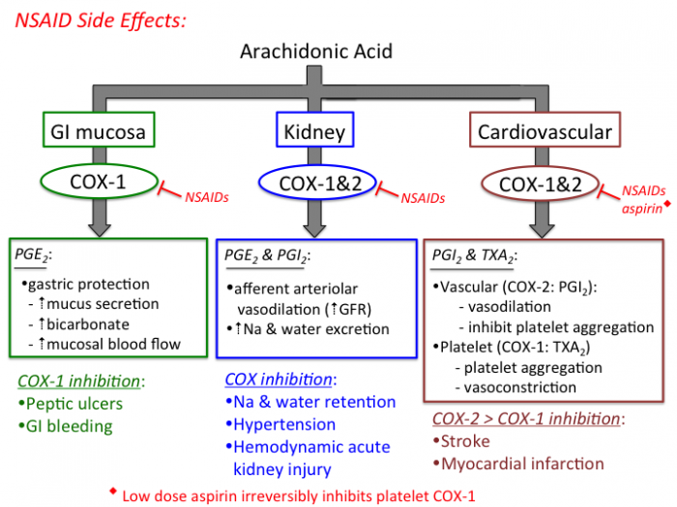
NSAIDs

Slide 19
GI Safety of NSAIDs

Slide 20
NSAIDs
Mechanism:
NSAIDs injure the gut by causing topical injury to the mucosa and by systemic effects associated with mucosal prostaglandin depletion derived from COX inhibition .
Platelet inhibition has also been considered to be a key mechanism of bleeding of lesions of the GI tract.
The systemic effects of NSAIDs appear to have a predominant role: enteric-coated aspirin preparations and parenteral or rectal administration of NSAIDs to prevent topical mucosal injury, has not been successful to prevent the development of gastroduodenal ulcers

Slide 21
NSAIDs
The highest gastrointestinal toxicity:
ketorolac, piroxicam, and ketoprofen
Safer NSAIDs:
Diclofenac, Aceclofenac, Ibuprofen
Piroxicam- Indometacin- Ketorolac> Tolmetin> Naproxen> Diclofenac> Ibuprofen

Slide 22
COX-2 HYPOTHESIS Inhibition of COX-2 will reduce inflammation without causing gastrointestinal ulcers and ulcer complication

Slide 24
COX-2 selective inhibitors (COXIBs)
Highly COX-2 selective inhibitors (COXIBs) | ModeratelyCOX-2 selective inhibitors (COXIBs)
Etoricoxib (Currently it is approved in more than 80 countries worldwide but not in the US) | Celecoxib
Rofecoxib | Etodolac
Lumiracoxib | Meloxicam
Parecoxib (It is approved through much of Europe for short term perioperative pain control much in the same way ketorolac (Toradol) is used in the United States)
Valdecoxib
Red= Withdraw from Market

Slide 25
NSAIDs

Slide 26
Conventional NSAIDs versus COX-2 selective agents
GI Adverse Effect
COX-2 inhibitors are associated with a significantly lower incidence of gastric and duodenal ulcers when compared to traditional NSAIDs.
However, this beneficial effect is negated when the patient is taking concomitant low-dose aspirin.
PPIs significantly reduce gastric and duodenal ulcers and their complications in patients taking NSAIDs or COX-2 inhibitors.
N Engl J Med 2000
The FASEB Journal 2004
Lancet 2007

Slide 27
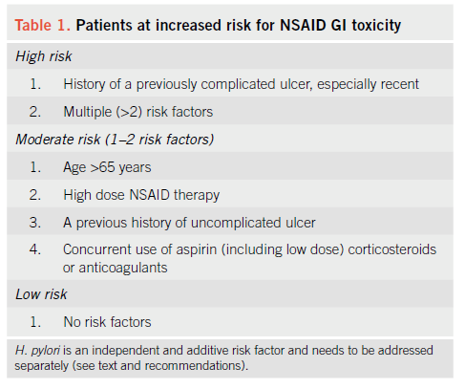
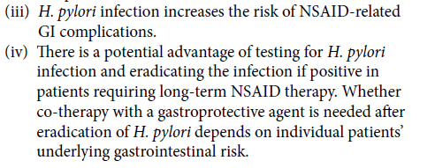
NSAIDs
Guidelines for Prevention of NSAID-Related Ulcer Complications. The American Journal of GASTROENTEROLOGY, 2009

Slide 28
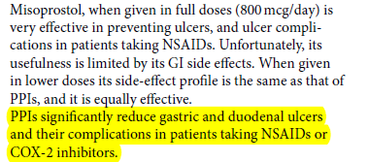
Guidelines for Prevention of NSAID-Related Ulcer Complications. The American Journal of GASTROENTEROLOGY, 2009

Slide 29
CV Safety of NSAIDs

Slide 30
NSAIDs
The importance of prostanoids in maintaining CV homeostasis was primarily highlighted by the evidence that the NSAID, aspirin, at low-doses, reduces the secondary incidence of myocardial infarction and stroke by approximately one quarter.
In contrast to aspirin, tNSAIDs and coxibs are associated with an increased CV risk
Applied Therapeutics. 2018
UpToDate 2018

Slide 32
NSAIDs
A network meta-analysis including 31 randomized controlled trials (116,429 patients) further supported evidences of the CV risk related to both COX-2 inhibitors and tNSAIDs, showing that:
Rofecoxib and lumiracoxib were associated with the highest risk of MI
Ibuprofen and diclofenac were associated with the highest risk of stroke
Naproxen seemed least harmful.
Applied Therapeutics. 2018
UpToDate 2018
BMJ2011;342:c7086

Slide 33
NSAIDs
In patients with and without cardiovascular disease, the use of most NSAIDs and COX2 inhibitors is associated with an increased risk of adverse cardiovascular events, including death, myocardial infarction (MI), heart failure (HF), and stroke. The risk varies depending upon the baseline cardiovascular event risk of the patient, the NSAID chosen, and its dose.
Applied Therapeutics. 2018
UpToDate 2018

Slide 35
NSAIDs
Could NSAIDs block the antiplatelet effect of ASA?
In 2006, the FDA released a warning statement on the concomitant use of both aspirin and ibuprofen.
Treatment with ibuprofen prior to ASA blocked this effect
No reduction in platelet inhibition when given after ASA
Taking ibuprofen at least 2 hours after daily dose of aspirin, as well as taking daily aspirin dose at least 8 hours after the last dose of ibuprofen
Applied Therapeutics. 2018. UpToDate 2018
N Engl J Med 2001; 345: 1809-

Slide 36
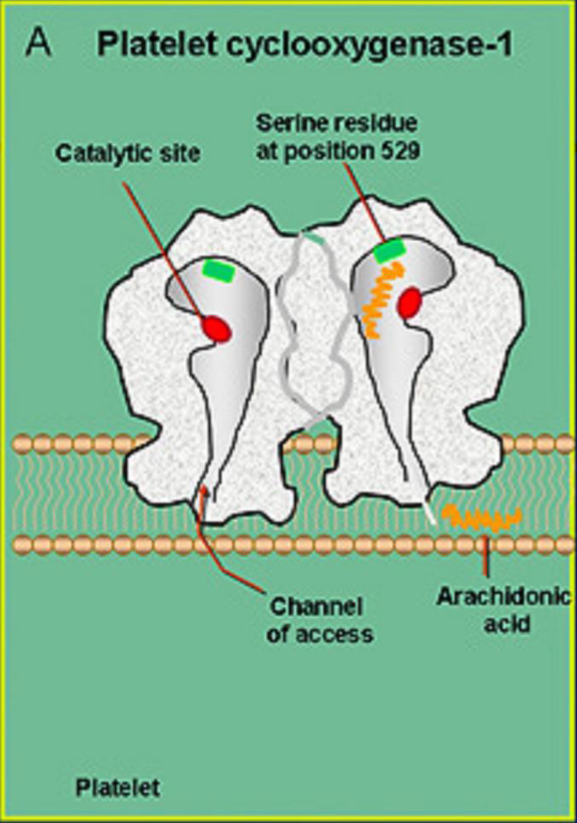
N Engl J Med 2001; 345: 1809-17

Slide 37
Recent findings suggest that the possible interference of naproxen on the antiplatelet effect of aspirin can be minimized by the administration of aspirin 2 h before naproxen
Guidelines for Prevention of NSAID-Related Ulcer Complications. The American Journal of GASTROENTEROLOGY, 2009. UpToDate 2018

Slide 38
Kidney Safety of NSAIDs

Slide 39
NSAIDs
In states of decreased renal perfusion, prostaglandins E2 and I2 compensate for the afferent arteriole vasoconstriction by stimulating afferent arteriole vasodilation, thereby enhancing renal blood flow. Prostaglandin synthesis is mediated predominantly by COX-1 and perhaps COX-2.
NSAIDs are often overlooked as causes of AKI. NSAIDs exert their pharmacologic effect by inhibiting prostaglandin synthesis, thereby negating compensatory vasodilation
Applied Therapeutics. 2018

Slide 40
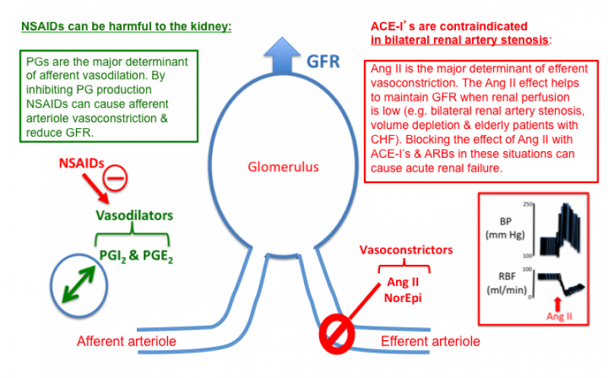

Slide 41
NSAIDs
COX-2 inhibitors also inhibit prostaglandin synthesis.
A study comparing the effects of rofecoxib and celecoxib to nonselective NSAIDs demonstrated similar renovascular effects
In a large cohort of more than 1.4 million new NSAID users receiving care in the US Department of Veterans Affairs health care system, however, a greater risk of AKI (based on AKIN criteria) was found in nonselective versus COX-2 selective agents.
Applied Therapeutics. 2018
Am J Epidemiol.2006;164:881
Pharmacoepidemiol Drug Saf.2009;18:923

Slide 42
NSAIDs
AKI risk was highest in the first 45 days of treatment initiation
The highest risk was found in those using more than one NSAID, in those switching from one agent to another.
The lowest risk was found in those using the same agent continuously.
Applied Therapeutics. 2018
Am J Epidemiol.2006;164:881
Pharmacoepidemiol Drug Saf.2009;18:923
Am J Med. 2008;121:1092

Slide 43
NSAIDs
High dose aspirin (defined as doses of at least 400 mg) is associated with the highest AKI risk. Naproxen, piroxicam, ketorolac, etodolac, indomethacin, sulindac, ibuprofen, and salsalate are also associated with a higher risk of AKI.
Celecoxib, meloxicam, diclofenac are not associated Significantly with AKI.
Applied Therapeutics. 2018
Am J Epidemiol.2006;164:881
Pharmacoepidemiol Drug Saf.2009;18:923

Slide 44
Consternation
Master Ali Asghar Tajvidi’s

Slide 45
TOPICAL THERAPY
Topical therapies present a valuable therapeutic option for OA pain management, with substantial evidence supporting the efficacy and safety of topical NSAIDs, but less robust support for capsaicin and salicylates.
Applied Therapeutics. 2018
Arthritis Care & Research 2012; 64: 465-474

Slide 46
TOPICAL THERAPY
Topical NSAIDs
Topical NSAIDs have an established role in the pharmacologic management of OA in Europe and were first approved in the United States in 2007.
Using topical NSAIDs in inflammatory rheumatic diseases leads to a 40% reduction in the need for concomitant oral NSAIDs, with a reduction in the reporting of GI side effects.
Globally, topical preparations are available for diclofenac, eltenac, felbinac, ibuprofen, ketoprofen, and piroxicam.
Applied Therapeutics. 2018
Arthritis Care & Research 2012; 64: 465-474

Slide 47
TOPICAL THERAPY
Bioavailability of Topical NSAIDs
As the largest human organ, the skin forms a barrier between the organism and the environment.
The uppermost layer, the stratum corneum, forms the most important barrier to absorption in the epidermis, with a high lipid and very low water content, and is the rate limiting step for epidermal drug transport
Applied Therapeutics. 2018
Seminars in Arthritis and Rheumatis. 2015: In Press

Slide 48
TOPICAL THERAPY
Bioavailability of Topical NSAIDs
There are great variations in the permeability of the skin to different substances. Whilst both purely hydrophilic and purely lipophilic substances are barely absorbed through the skin, there are very high absorption rates for predominantly lipophilic substances with a certain residual hydrophilia.
Applied Therapeutics. 2018
Seminars in Arthritis and Rheumatis. 2015: In Press

Slide 49
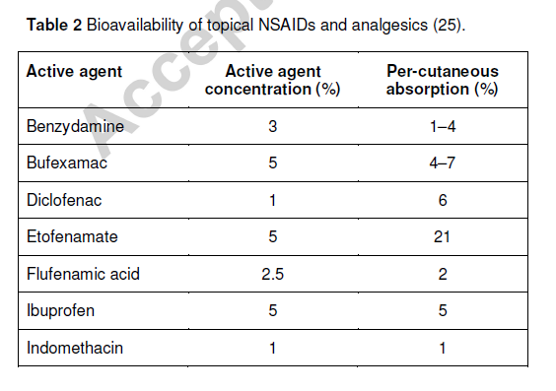
TOPICAL THERAPY
Seminars in Arthritis and Rheumatis. 2015: In Press

Slide 50
TOPICAL THERAPY
Oral NSAIDs should not be used concomitantly with the topical solution because of the increased risk of rectal bleeding and abnormal laboratory findings.
In a 2010 systematic review, oral and topical NSAIDs were noted to have similar rates for discontinuation because of a high incidence of topical reactions with the latter.
Applied Therapeutics. 2018
Drugs 2011; 71 (10)

Slide 51
TOPICAL THERAPY
Salicylates
Non-acetylated salicylates are derived from aspirin (acetylsalicylic acid) but do not share the same mechanism of action as NSAIDs. In fact, preclinical data suggest that non-acetylated salicylates inhibit COX-2 approximately 100-fold less than does acetylsalicylic acid
Applied Therapeutics. 2018
Drugs 2011; 71 (10)

Slide 52
TOPICAL THERAPY
Salicylates
Topical salicylates have shown substantially less efficacy than the topical NSAIDs and are associated with substantial systemic salicylate exposure and serious toxicity.
Topical salicylates and oral NSAIDs share several adverse effects in common, most notably GI upset, impaired platelet function and interaction with warfarin.
Applied Therapeutics. 2018
Drugs 2011; 71 (10)

Slide 53
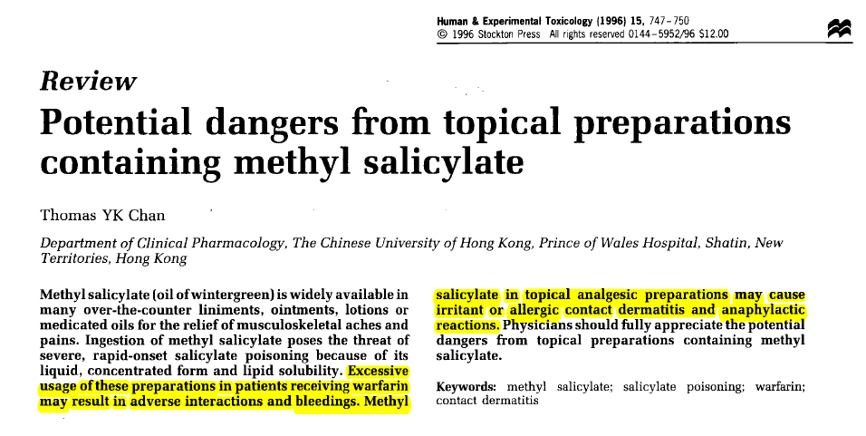
TOPICAL THERAPY

Slide 54
TOPICAL THERAPY
AEs associated with acute salicylate poisoning include nausea and vomiting, tinnitus and deafness, CNS effects (e.g. confusion), drowsiness, tachycardia, tachypnea and hyperventilation, metabolic acidosis, impaired platelet aggregation, muscle necrosis and interstitial nephritis
Drugs 2011; 71 (10)

Slide 55
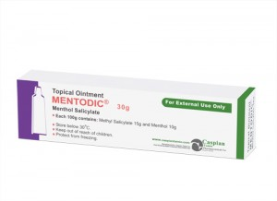
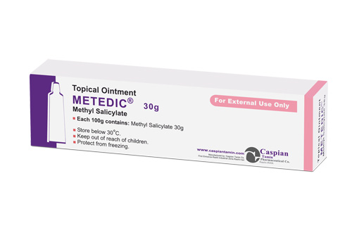
TOPICAL THERAPY
Menthol Salicylate vs Methyl Salicylate
Menthol Salicylate: each 100 gr contains: Methyl Salicylate 15 g and Menthol 10 g
Methyl Salicylate: each 100 gr contains: Methyl Salicylate 30 g

Slide 56
TOPICAL THERAPY
Capsaicin
Capsaicin is the active ingredient of chili peppers and similar plants in the capsicum family.
The mechanism of action is thought to be due to a reduction in pain-related neuropeptides such as substance P, with blockade of afferent input.
There is some evidence that topical capsaicin is better than placebo for treatment of pain from diabetic neuropathy, osteoarthritis and possibly psoriasis.
Applied Therapeutics. 2018
Arthritis Care & Research 2012; 64: 465-474
Pain Res Manage 2006; 7 (1): 12-36

Slide 57
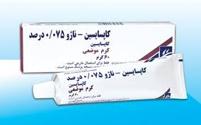
TOPICAL THERAPY
Capsaicin
Capsaicin may be beneficial to some patients with neuropathic or arthritic pain as an adjuvant analgesic, but is unlikely to be adequate as the sole analgesic agent.
The frequency of application of cream should be four to five times daily. Treatment should persist for four to six weeks, because the onset and best response may take this long to occur.
Applied Therapeutics. 2018
Arthritis Care & Research 2012; 64: 465-474
Pain Res Manage 2006; 7 (1): 12-36

Slide 58
TOPICAL THERAPY
Capsaicin
The adverse effect is a burning sensation. This will occur in 80% of patients. The severity of burning appears to be worse in conditions such as post-herpetic neuralgia or psoriasis where the skin is permanently scarred, than in pain conditions where the skin is normal. The burning may decrease with repeated applications. Coughing and sneezing can occur. To date, there has been no evidence of toxic effects on nerves with the low doses used in topical application, although this is a concern
Applied Therapeutics. 2018
Arthritis Care & Research 2012; 64: 465-474
Pain Res Manage 2006; 7 (1): 12-36

Slide 59
TOPICAL THERAPY
Drugs 2011; 71 (10)

Slide 60
گیاه اصلی | کد IRC | تولید کننده | نام دارو گیاهی
زردچوبه | ۱۲۲۸۱۲۰۸۵۵ | داروسازی حکیم مومن تیریزی | پماد اکبر 2
اکلیل کوهی | ۱۲۲۸۰۲۲۷۴۶ | داروسازی گل دارو | پماد رزماری
پنجه شیطان | ۱۲۲۸۱۴۱۶۹۰ | داروسازی رها | پماد موضعی رهامین
پنجه شیطان | ۱۲۲۸۱۵۸۳۰۸ | Ardeypharm Gmbh | قرص دلتفین
پنجه شیطان | ۱۲۲۸۱۸۶۶۳۹ | داروسازی رازک | قرص تالنتال ۴۸۰ میلی گرم
پنجه شیطان | ۱۲۲۸۱۴۶۳۷۴ | داروسازی گل دارو | قرص روکشدار روماتوگل
زردچوبه | ۱۲۲۸۱۰۷۹۱۷ | داروسازی گل دارو | کپسول فیتوآرتریت

Slide 61
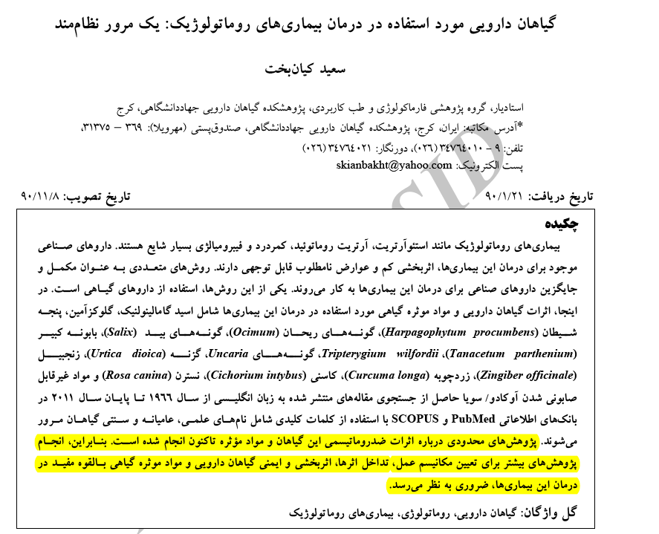

Slide 62
Bahram e Goor
Master Ali Asghar Tajvidi’s

